Slide 3
Introduction
An input program that is grammatically correct may still contain serious errors that would prevent compilation.
To detect such errors, a compiler performs a further level of checking that involves considering each statement in its actual context.
it needs knowledge about the input program that goes well beyond syntax
It needs detailed computation encoded in the input program.
It must know what values are represented, where they reside, and how they flow from name to name.
All of these facts can be derived from the source code, using contextual knowledge, by deeper analysis.
These kinds of analysis are either performed alongside parsing or in a postpass that traverses the IR produced by the parser.
We call this analysis either “context-sensitive analysis,” to differentiate it from parsing, or “semantic elaboration,” since its elaborates the IR.
We will discuss two techniques for context-sensitive checking
(1) Attribute grammars.
(2) Syntax-directed translation.

Slide 4
Introduction…
To accumulate the contextual knowledge needed for further translation, the compiler must develop ways of viewing the program other than syntax.
The compiler must
- use abstractions that represent some aspect of the code, such as a type system, a storage map, or a control-flow graph.
- understand the program’s name space: the kinds of data represented in the program, the kinds of data that can be associated with each name and their mapping.
- understand the flow of control, both within procedures and across procedures.
We will discuss the mechanisms that compilers use to derive context sensitive knowledge.
The abstractions that the compiler manipulates during semantic elaboration – called as ‘the type system’.
A principled automatic approach to implementing these computations in the form of attribute grammars.
(3) The most widely used technique, ad hoc syntax directed Translation.

Slide 5
Introduction…
Consider a single name used in the program being compiled; let’s call it x.
Before the compiler can emit executable target-machine code for computations involving x, it must have answers to many questions.
What kind of value is stored in x?
How big is x?
If x is a procedure, what arguments does it take? What kind of value, if any, does it return?
How long must x’s value be preserved?
Who is responsible for allocating space for x (and initializing it)?
The compiler must derive the answers to these questions, and more, from the source program and the rules of the source language.

Slide 7
An Introduction to Type System
Most programming languages associate a collection of properties with each data value.
We call this collection of properties the value’s type.
The type specifies a set of properties held in common by all values of that type.
Type can be specified by membership
For example,
an integer might be any whole number i in the range -2³¹ < i < 2³¹, or
‘red’ might be a value in an enumerated type colors, defined as the set {red, orange, yellow, green, blue, brown, black, white}
(2) Type can be specified by rules
For Example – “the declaration of a structure in c defines a type.”
- it specifies the structure name, individual component’s data type and size.
“Some types are predefined in the programming languages and some are define by the users”
“For a language, the set of type and the rules to use the types are collectively called as type system”
Int a = 10 ;
float b = 2.3;

Slide 9
An Introduction to Type System
The purpose of a type system
Programming-language designers introduce type systems so that they can specify program behavior at a more precise level than is possible in a context-free grammar.
The type system creates a second vocabulary for describing both the form and behavior of valid programs.
Analyzing a program from the perspective of its type system yields information that cannot be obtained using the techniques of scanning and parsing.
In a compiler, this information is typically used for three distinct purposes: safety, expressiveness, and runtime efficiency.

Slide 10
An Introduction to Type System
The purpose of a type system
Ensuring Runtime Safety
A well-designed type system helps the compiler detect and avoid runtime errors.
The type system should ensure that programs are well behaved at Compile time and Run time.
That is it can identify all ill-formed programs before they execute an operation that causes a runtime error.
The type system cannot catch all ill-formed programs.
However, the compiler should eliminate as many runtime errors as it can using type-checking techniques.
To accomplish this, the compiler must
First, infer a type for each expression.
(2) Second, the compiler must check the types of the operands of each operator against the rules.
In some cases, the compiler to type convert the values.
In other circumstances, they declare that the program is ill formed and, therefore, not executable.

Slide 11
An Introduction to Type System
The purpose of a type system
Safety is a strong reason for using typed languages.
A language implementation that guarantees to catch most type-related errors before they execute can simplify the design and implementation of programs.
A language in which every expression can be assigned an unambiguous type is called a strongly typed language.
If every expression can be typed at compile time, the language is statically typed; if some expressions can only be typed at runtime, the language is dynamically typed.
Two alternatives exist: an untyped language, such as assembly code or bcpl, and a weakly typed language—one with a poor type system.

Slide 12
An Introduction to Type System
The purpose of a type system
Improving Expressiveness
A well-constructed type system allows the language designer to specify behavior more precisely than is possible with context-free rules.
Example: ‘Operator overloading’ can not be expressed by CFG.
Generating Better Code
A well-designed type system provides the compiler with detailed information about every expression in the program—information that can often be used to produce more efficient translations.
Type Checking
To avoid the overhead of runtime type checking, the compiler must analyze the program and assign a type to each name and each expression.
It must check these types to ensure that they are used in contexts where they are legal.
Taken together, these activities are often called type checking.

Slide 14
An Introduction to Type System
Components of a type system
A type system for a typical modern language has four major components:
A set of base types, or built-in types;
Rules for constructing new types from the existing types;
A method for determining if two types are equivalent or compatible; and
Rules for inferring the type of each source-language expression.
(1) Base Types
Most programming languages include base types such as: numbers, characters, and booleans.
These types are directly supported by most processors.
The precise definitions for base types, and the operators defined for them, vary across languages.

Slide 15
An Introduction to Type System
Components of a type system
(2) Compound and Constructed Types
While the base types provide an adequate abstraction of the actual kinds of data handled directly by the hardware,
the programs routinely deal with more complex data structures, such as graphs, trees, tables, arrays, records, lists, and stacks. These structures consist of one or more objects, each with its own type.
The ability to construct new types for these compound or aggregate objects is an essential feature of many programming languages.
Other compound types: Strings, Enumerated Types, Structures and pointers.

Slide 16
An Introduction to Type System
Components of a type system
(3) Type Equivalence
A critical component of any type system is the mechanism that it uses to decide whether or not two different type declarations are equivalent.
Consider the two declarations in C shown in the RHS.
Are Tree and STree the same type?
Are they equivalent?
Any programming language with a type system must include an unambiguous rule to answer this question for arbitrary types.
Two general approaches have been tried
The first, name equivalence, asserts that two types are equivalent if and only if they have the same name.
(2) The second approach, structural equivalence, asserts that two types are equivalent if and only if they have the same structure.

Slide 17
An Introduction to Type System
Components of a type system
(4) Inference Rules
In general, type inference rules specify, for each operator, the mapping between the operand types and the result type.
An assignment, for example, has one operand and one result. ( A = B )
The result, or left-hand side, must have a type that is compatible with the type of the operand, or right-hand side.
This rule allows assignment of an integer value to an integer variable. It forbids assignment of a structure to an integer variable.
The inference rules point out type errors.
Some languages require the compiler to perform implicit conversions.

Slide 18
An Introduction to Type System
Components of a type system
(4)…Declarations and Inference
Many programming languages include a “declare before use” rule, for variables.
The compiler needs a way to assign types to constants.
Two approaches are common.
Either a constant’s form implies a specific type for example, 2 is an integer and 2.0 is a floating-point number.
(2) The compiler infers a constant’s type from its usage
for example,
sin(2) implies that 2 is a floating-point number,
x ← 2, for integer x, implies that 2 is an integer.
With declared types for variables, implied types for constants, and a complete set of type-inference rules, the compiler can assign types to any expression over variables and constants.
Eg. As a basic example, consider the function Foo(a,b) = x + y; the compiler knows that the "+" operator takes two integers and also returns an integer, so now the compiler can infer that Foo also has the type integer.

Slide 19
An Introduction to Type System
Components of a type system
(4)…Inferring Types for Expressions
The goal of type inference is to assign a type to each expression that occurs in a program.
The simplest case for type inference occurs when the compiler can assign a type to each base element in an expression—that is, to each leaf in the parse tree for an expression.
(Example: Sum = M1 + M2 + Total(x, y, z ) + 88)
This requires declarations for all variables, inferred types for all constants, and type information about all functions.
Conceptually, the compiler can assign a type to each value in the expression during a simple postorder tree walk.
This should let the compiler detect every violation of an inference rule, and report it at compile time.

Slide 20
An Introduction to Type System
Components of a type system
(4)…Interprocedural Aspects of Type Inference
Type inference for expressions depends, inherently, on the other procedures that form the executable program.
Even in the simplest type systems, expressions contain function calls.
(Example: Sum = M1 + M2 + Total(x, y, z ) + 88)
The compiler must check each of those calls.
It must ensure that each actual parameter is type compatible with the corresponding formal parameter.
It must determine the type of any returned value for use in further inference.
To analyze and understand procedure calls, the compiler needs a type signature for each function.
For example, the strlen function in c’s standard library takes an operand of type char * and returns an int that contains.
In c, the programmer can record this fact with a function prototype that looks like:
unsigned int strlen(const char *s);

Slide 22
The attribute-grammar framework
The attribute grammar, or attributed context-free grammar – is a formalism that has been proposed for performing context-sensitive analysis.
An attribute grammar consists of a context-free grammar augmented by a set of rules that specify computations.
Each rule defines one value, or attribute in terms of the values of other attributes.
The rule associates the attribute with a specific grammar symbol; each instance of the grammar symbol that occurs in a parse tree has a corresponding instance of the attribute.
The rules are functional; they imply no specific evaluation order and they define each attribute’s value uniquely.

Slide 23
The attribute-grammar framework
Consider a context-free grammar for signed binary numbers.
Figure 4.4 defines the grammar SBN = (T, NT, S, P).
SBN generates all signed binary numbers, such as -101, +11, -01, and +11111001100.
It excludes unsigned binary numbers, such as 10.
To build an attribute grammar, we must decide what attributes each node needs, and we must elaborate the productions with rules that define values for these attributes.
For our attributed version of SBN, the following attributes are needed:
From SBN, we can build an attribute grammar that annotates Number with the value of the signed binary number that it represents.
no attributes are needed for the terminal symbols

Slide 24
The attribute-grammar framework
Figure 4.5 shows the productions of SBN elaborated with attribution rules.
-101, +11, -01, and +11111001100
Subscripts are added to grammar symbols whenever a specific symbol appears multiple times in a single production. (List in production 5 have subscripts)

Slide 25
The attribute-grammar framework
The rules add attributes to the parse tree nodes by their names.
An attribute mentioned in a rule must be instantiated for every occurrence of that kind of node.
Attributed parse tree
Normal parse tree
Parse tree for the string: -101

Slide 26
The attribute-grammar framework
Each rule specifies the value of one attribute in terms of literal constants and the attributes of other symbols in the production.
A rule can pass information from the production’s left-hand side to its right-hand side; a rule can also pass information in the other direction.
The rules for production 4 pass information in both directions.
Given a string in the SBN grammar, the attribution rules set Number.value to the decimal value of the binary input string.
ie., -101 as -5.

Slide 27
The attribute-grammar framework
For example, the string -101 causes the attribution shown in Figure 4.6a.
Notice that Number.value has the value -5.
To evaluate an attributed parse tree for some sentence in L(SBN), the attributes specified in the various rules are instantiated for each node in the parse tree.

Slide 28
value and negative attributes are synthesized.
the position attribute is inherited.

Slide 29
The attribute-grammar framework
Figure 4.6b shows the attribute-dependence graph induced by the parse tree for the string -101.
To evaluate an attributed parse tree for some sentence in L(SBN), the attributes specified in the various rules are instantiated for each node in the parse tree.
This creates, for example, an attribute instance for both value and position in each List node.
Each rule implicitly defines a set of dependences; the attribute being defined depends on each argument to the rule.
Taken over the entire parse tree, these dependences form an attribute dependence graph.
Edges in the graph follow the flow of values in the evaluation of a rule; an edge from node_{i} . field_{j} to node_{k}.field_{l} indicates that the rule defining node_{k} . field_{l} uses the value of node_{i} .field_{j} as one of its inputs.

Slide 30
The attribute-grammar framework
The bidirectional flow is shows up in the dependence graph. The List nodes show this effect most clearly.
There are two attributes based on the direction of value flow
Synthesized attributes are defined by bottom-up information flow; a rule that defines an attribute for the production’s left-hand side creates a synthesized attribute.
A synthesized attribute can draw values from the node itself, its descendants in the parse tree, and constants.
Inherited attributes are defined by top-down and lateral information flow; a rule that defines an attribute for the production’s righthand side creates an inherited attribute.
Since the attribution rule can name any symbol used in the corresponding production, an inherited attribute can draw values from the node itself, its parent and its siblings in the parse tree, and constants.
value and negative attributes are synthesized.
the position attribute is inherited.

Slide 32
The attribute-grammar framework
Evaluation Methods
To create an implementation, the compiler writer must create an evaluator.
This can be done with an ad hoc program or by using an evaluator generator—the more attractive option.
The evaluator generator takes as input the specification for the attribute grammar. It produces the code for an evaluator as its output.
Many attribute evaluation techniques have been proposed in the literature.
Dynamic Methods
Oblivious Methods
Rule-Based Methods

Slide 34
The attribute-grammar framework
Circularity
The syntax of the attribution rules allows a rule to reference its own result, either directly or indirectly.
An attribute grammar containing such rules is ill formed.
We say that such rules are circular because they can create a cycle in the dependence graph.
Our models for evaluation fail when the dependence graph contains a cycle.
A failure of this kind in a compiler causes serious problems—for example, the compiler might not be able to generate code for its input.
If a compiler uses attribute grammars, it must handle circularity in an appropriate way. Two approaches are possible. (1) Avoidance and (2) Evaluation

Slide 36
The attribute-grammar framework
Extended examples
In many languages, the compiler can infer a type for every expression.
FORTRAN 77 has a particularly simple type system with just a handful of types.
Figure 4.1 shows all the cases that can arise for the + operator.
Given an expression a + b and the types of a and b, the table specifies the type of a + b.
For an integer a and a double-precision b, a + b produces a double-precision result.
If, instead, a were complex, a + b would be illegal.

Slide 37
The attribute-grammar framework
Extended examples
Any compiler confront the problem of inferring types for every expression in the program.
Consider a simplified version of the type inference problem for expressions derived from the classic expression grammar.
For each arithmetic operator in the grammar, we need a function that maps the two operand types to a result type.
We will call these functions F+, F-, FX, and F÷, they encode the information found in table 4.1.
Table 4.1
With these assumptions, we can write simple attribution rules that define a type attribute for each node in the tree.
Figure 4.7 shows the attribution rules.

Slide 38
The attribute-grammar framework
Extended examples
If a has type integer (denoted I ) and c has type real (denoted R), then this scheme generates the following attributed parse tree for the input string a - 2 × c:
The leaf nodes have their type attributes initialized appropriately. The remainder of the attributes are defined by the rules from Figure 4.7, with the assumption that F+, F-, FX, and F÷, reflect the FORTRAN 77 rule.
All the attributes are synthesized attribute in this example. So, this grammar is called S-attributed grammars.

Slide 39
The attribute-grammar framework
Extended examples
A Simple Execution-Time Estimator – for self study.
As a second example, consider the problem of estimating the execution time of a sequence of assignment statements.
We can generate a sequence of assignments by adding three new productions to the classic expression grammar:
Figure 4.8 shows an attribute grammar that estimates the execution time of a block of assignment statements.

Slide 41
AD HOC SYNTAX-DIRECTED TRANSLATION
The rule-based evaluators for attribute grammars introduce a powerful idea that serves as the basis for the ad hoc techniques used for context-sensitive analysis in many compilers.
In the rule-based evaluators, the compiler writer specifies a sequence of actions that are associated with productions in the grammar.
We refer to this approach as ad hoc syntax-directed translation.
In this scheme, the compiler writer provides snippets of code that execute at parse time.
Each snippet, or action, is directly tied to a production in the grammar.
Each time the parser recognizes that it is at a particular place in the grammar, the corresponding action is invoked to perform its task.
To implement this in a top-down, recursive-descent parser, the compiler writer simply adds the appropriate code to the parsing routines.
In a bottom-up, shift-reduce parser, the actions are performed each time the parser performs a reduce action.

Slide 42
AD HOC SYNTAX-DIRECTED TRANSLATION
Consider reformulating the signed binary number example in an ad hoc syntax-directed translation framework.
Figure 4.11 shows one such framework.
Each grammar symbol has a single value associated with it, denoted val in the code snippets.
The code snippet for each rule defines the value associated with the symbol on the rule’s left-hand side.
Rule 1 simply multiplies the value for Sign with the value for List.
Rules 2 and 3 set the value for Sign appropriately, just as rules 6 and 7 set the value for each instance of Bit.
Rule 4 simply copies the value from Bit to List.
The real work occurs in rule 5, which multiplies the accumulated value of the leading bits (in List.val) by two, and then adds in the next bit.

Slide 43
AD HOC SYNTAX-DIRECTED TRANSLATION
AHSDT looks quite similar to an attribute grammar.
However, it has two key simplifications.
(1) Values flow in only one direction, from leaves to root.
(2) It allows only a single value per grammar symbol.
This scheme also computes the value of the signed binary number, and leaves that value at the root of the tree, just like the attribute grammar.

Slide 44
AD HOC SYNTAX-DIRECTED TRANSLATION
These two simplifications make possible an evaluation method that works well with a bottom-up parser, such as the LR(1) parsers.
Since each code snippet is associated with the right-hand side of a specific production, the parser can invoke the action each time it reduces by that production.
This requires minor modifications to the reduce action in the skeleton LR(1) parser shown in Figure 3.1, Chapter 3.

Slide 45
AD HOC SYNTAX-DIRECTED TRANSLATION
The parser generator can gather the syntax-directed actions together, embed them in a case statement that switches on the number of the production being reduced, and place the case statement just before it pops the right-hand side from the stack.

Slide 46
Context Sensitive Analysis Adhoc syntax-directed translation (AHSDT)
Nalinadevi Kadiresan, CSE DEPT.
AMRITA SCHOOL OF ENGG.

Slide 47
The Realist’s Alternative Adhoc syntax-directed translation(AHSDT)
An ad hoc techniques is to annotate the grammar with executable rules
These rules are known as action routines
It is a rule based evaluation method (treewalk)
Analyze rules at compiler-generation time
Determine a fixed (static) ordering
Evaluate nodes in that order
Associate a snippet of code with each production
At each reduction/derivation, the corresponding snippet/action is executed
AHSDT nicely fits into parsers
Top-down, Recursive-Descent Parser
(evaluated with only Non S-attributed Grammar)
Bottom-up, shift/reduce Parsers
(evaluated with only S-attributed Grammar)

Slide 48
AHSDT
Automatic tools can construct a parser for a given context-free grammar
E.g. ANTLR (for LL(1) with left recursion) ,
CUP and YACC (for LR(1))
Automatic tools can construct a semantic analyzer for an attribute grammar
Next Let us see AHSDT in LR(1) and LL(1) Parser !!!!

Slide 49
AHSDT in LR(1) parser
S-attributed Grammar
S => E { S.val = E.val}
E => E + T { E.val := E1.val + T.val }
E => T { E.val := T.val}
T => T * F { T.val := T1.val * F.val }
T => F { T.val := F.val }
F => ( E ) { F.val := E.val}
F => const { F.val := Const.val }

Slide 50
ANTLR spec for previous slide
grammar expression;
start returns [Integer value] : e=exp {$value=$e.value; System.out.println("Syntatically correct and evaluated expression is."+$value);} ;
exp returns [Integer value] : e1=exp (PLUS ) e2=term {$value=$e1.value+$e2.value;} | t=term {$value=$t.value;} ;
term returns [Integer value] : t=term (TIMES) f=factor {$value=$t.value*$f.value;} | f=factor {$value=$f.value;} ;
factor returns [Integer value]: LPAREN e=exp RPAREN
{$value=$e.value;} | NUM {$value=Integer.parseInt($NUM.text);} ;
LPAREN : '(‘ ; RPAREN : ')‘ ; PLUS : '+‘ ;
MINUS : '-‘ ; TIMES : '*‘ ; DIV : '/‘ ;
NUM : [0-9]+ ; WS : [ \r\n\t] + -> skip ;

Slide 51
AHSDT in LL(1) Parser
L-attributed Grammar
E => T { TT.st := T.v } TT { E.v := TT.v }
TT => + T { TT2.st := TT1.st + T.v } TT { TT1.v := TT2.v }
TT => - T { TT2.st := TT1.st - T.v } TT { TT1.v := TT2.v }
TT => { TT.v := TT.st }
T => F { FT.st := F.v } FT { T.v := FT.v }
FT => * F { FT2.st := FT1.st * F.v } FT { FT1.v := FT2.v }
FT => / F { FT2.st := FT1.st / F.v } FT { FT1.v := FT2.v }
FT => { FT.v := FT.st }
F => - F { F1.v := - F2.v }
F => ( E ) { F.v := E.v }
F => const { F.v := C.v }

Slide 52
ANTLR specification of previous slide
grammar hello;
start : expr EOF { System.out.println($expr.val); };
expr returns [int val] : term exprP[$term.val] { $val = $exprP.val; };
exprP[int i] returns [int val]: { $val = $i; }
| '+' term e = exprP[$i + $term.val] { $val = $e.val; }
| '-' term e = exprP[$i - $term.val] { $val = $e.val; };
term returns [int val] : fact termP[$fact.val]{ $val = $termP.val; };
termP[int i] returns [int val]: { $val = $i; }
| '*' fact e = termP[$i * $fact.val] { $val = $e.val; }
| '/' fact e = termP[$i / $fact.val] { $val = $e.val; }
;
fact returns [int val] : '(' expr ')' { $val = $expr.val; }
| NUM { $val = Integer.parseInt($NUM.text); };
ID : ('a'.. 'z'|'A'.. 'Z') ('a'.. 'z'|'A'.. 'Z'|'0'.. '9'|'_')* ;
NUM : '0'.. '9'+ ;
WS : [ \r\n\t] + -> skip ;

Slide 53
Chapter-1 Recap : A straight-line programming language
53
Grammar-3 : syntax of a straight-line program (that is, no control flow structures)
Stm → Stm; Stm (CompoundStm)
Stm → id := Exp (AssignStm)
Stm → print (ExpList) (PrintStm)
Exp → id (IdExp)
Exp → num (NumExp)
Exp → Exp Binop Exp (OpExp)
Exp → (Stm, Exp) (EseqExp)
ExpList → Exp, ExpList (PairExpList)
ExpList → Exp (LastExpList)
Binop →+ (Plus)
Binop →− (Minus)
Binop →× (Times)
Binop → / (Div)
A Sample SLP program
a := 5+3; b := (print(a, a-1), 10*a); print(b)

Slide 54
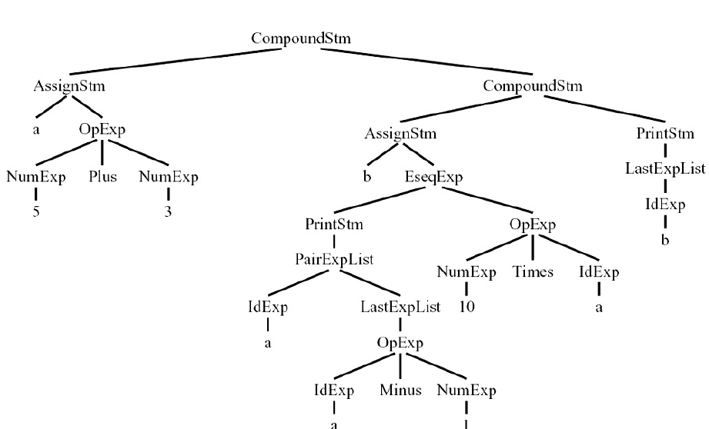
Tree representation of the following sample program for Grammar-3 a := 5+3; b := (print(a, a-1), 10*a); print(b)
54

Slide 55
Syntax separate from interpretation style of program
Step 1
The CFG(syntax) is converted to OO program
Step-2
The AST equivalence is obtained by writing an interpreter

Slide 56
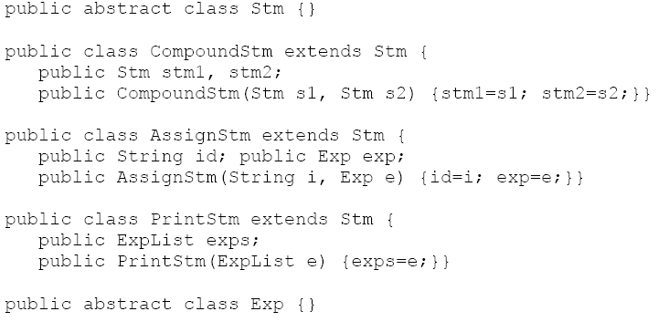
Step-1: Representation of syntax(Grammar-3) as a OO program
56
Note:
This OO program has only attributes and constructor
There is no methods. So concept of OO is not exploited

Slide 57
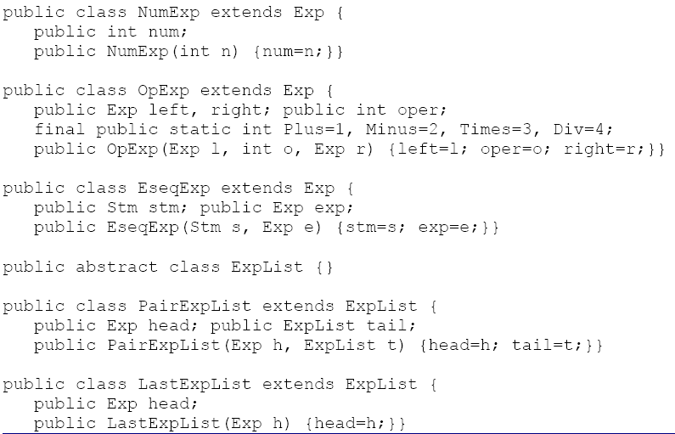
Step-1: Representation of syntax(Grammar-3) as a OO program (contd)
57

Slide 58
Step-2: Interpreter code for program representation of Grammar-3
a := 5+3; b := (print(a, a-1), 10*a); print(b)

Slide 60
Thank you………

